Slide 1

“Enhancing Visual Question Answering with Beam Search in Transformer Models”.
By Pavitra Arora
209302052
Under the guidance of
Dr. Bagesh kumar

Slide 2
Table of contents
1. Introduction and Aim
2. Dataset used
3. Comparison of Datasets
4. Literature Review Paper
5. Working of Model
6. Proposed Methodology
7. Pipeline
8. Model Selection and Configuration
9. Model Training and Evaluation
10. Output result
11. Comparison with other models
12. Conclusion
13. Future Scope

Slide 3
Introduction
Visual Question Answering (VQA) is a multifaceted and cross-disciplinary do?main that resides at the intersection of computer vision and natural language processing. As the intricacies of the visual world become increasingly apparent, the demand for robust AI systems capable of processing and interpreting these complexities rises in tandem. VQA offers an instrumental framework to meet this demand, compelling us to develop models that not only identify visual features within images but also comprehend the nuanced questions posed about them. In recent years, deep learning models have taken the lead in addressing VQA challenges. Among these models, Vilt-B32-MLM has emerged as a trailblazer. This model harnesses the potential of both Vision and Language Transformer (VilT) and Multimodal Transformer (MLM), seamlessly integrating the strengths of both domains. [5]

Slide 4
AIM
At its core, VQA aims to bridge the gap between human perception and understanding by allowing machines to interpret images and answer questions about them in a manner that's meaningful to humans. This task goes beyond traditional image analysis, which focuses on recognizing objects and patterns, and delves into the realm of understanding visual context in relation to language.

Slide 5
Dataset used
We utilize the Microsoft Common Objects in Context (MS COCO) dataset, comprising 123,287 images for training and validation, along with 81,434 test images [32]. The dataset was curated to encompass images with multiple objects and abundant contextual details, making them highly suitable for our Visual Question Answering (VQA) task.

Slide 6
Dataset-VQAv2
The Visual Question Answering v2 (VQAv2) dataset is a collection of over 250,000 diverse images from the MS COCO dataset, along with more than 760,000 open-ended questions about these images. It is made by MICROSOFT, published first time in 2014. We use updated version of 2021 MS-COCO Dataset. The dataset aims to evaluate AI models' ability to comprehend images and answer questions accurately. Each question is associated with multiple human-provided answers, reflecting the variability in interpretations. The questions cover a wide range of complexities, requiring a blend of skills in image understanding, language processing, and reasoning.

Slide 7
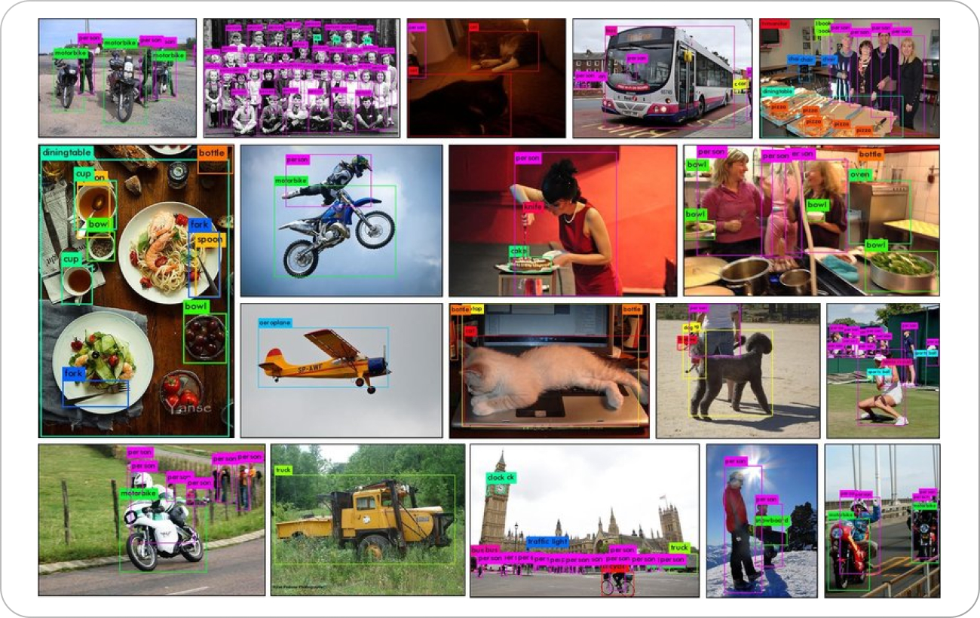
DATASET SAMPLE

Slide 8
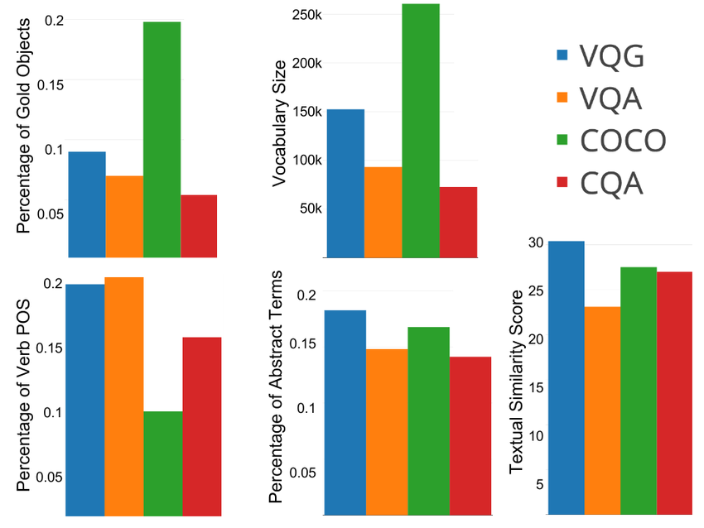
COMPARISON OF DATASETS

Slide 9
Literature Review Paper
Vision-and-Language Transformer Without Convolution or Region Supervision[1]
Accuracy : 72.76% on NLVR2 Dataset
The paper "ViLT: Vision-and-Language Transformer Without Convolution or Region Supervision" introduces a novel model called ViLT, which stands for Vision-and-Language Transformer. The main innovation of ViLT is that it combines vision and language information in a single transformer-based architecture, without using traditional convolutional neural networks (CNNs) or region-level supervision.

Slide 10
Literature Review Paper
Bottom-Up and Top-Down Attention for Image Captioning
and Visual Question Answering[2]
Accuracy : 72.76% on NLVR2 Dataset
The research paper titled "Bottom-Up and Top-Down Attention for Image Captioning and Visual Question Answering" proposes a combined attention mechanism for image captioning and visual question answering tasks
. The authors introduce a method that allows attention to be calculated at both the bottom-up and top-down levels, enabling a more comprehensive understanding of images and better performance in these tasks.

Slide 11
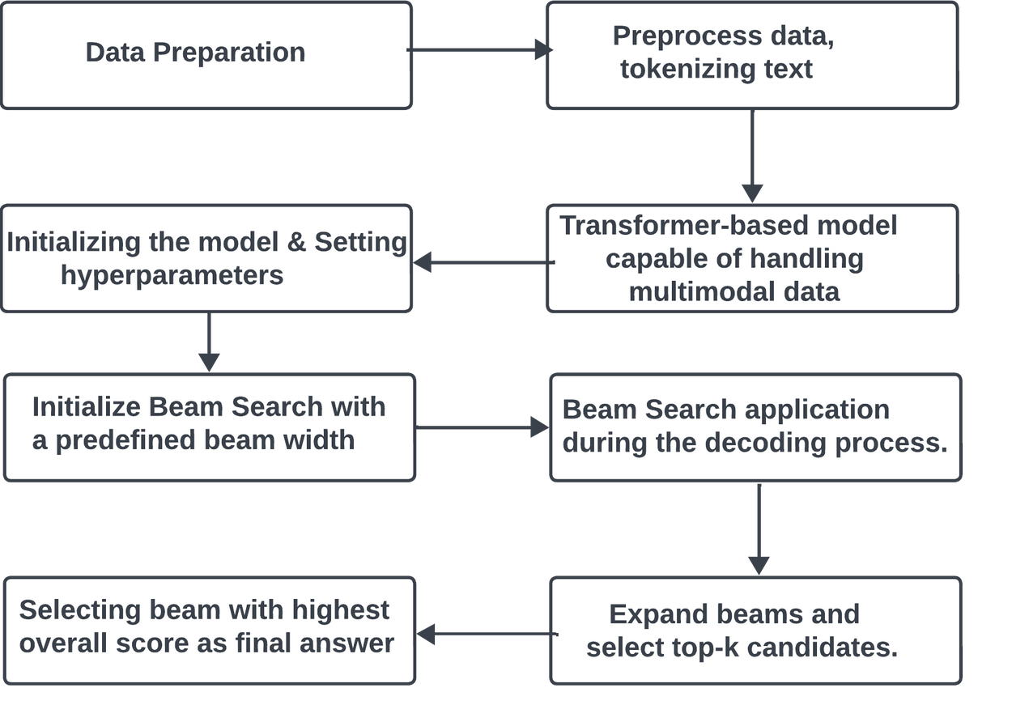
WORKING OF MODEL

Slide 12
PROPOSED METHODOLOGY
Our methodology for implementing Visual Question Answering (VQA) using the Vilt-B32-MLM model on the Microsoft Common Objects in Context (MS COCO) dataset comprises a series of well-defined steps that encompass data preparation, data processing, model architecture, and training strategies.

Slide 13
PROPOSED METHODOLOGY
1). Data Collection and Preparation:
Data preparation is a foundational pillar in the implementation of Visual Question Answering (VQA). It involves sourcing, organizing, and transforming data into a format that can be effectively ingested by the VQA model.
The cornerstone of our data preparation is the selection of an appropriate dataset. In our research, we turn to the Microsoft Common Objects in Context (MS COCO) dataset. MS COCO is renowned for its depth and diversity, making it an ideal choice for VQA tasks.

Slide 14
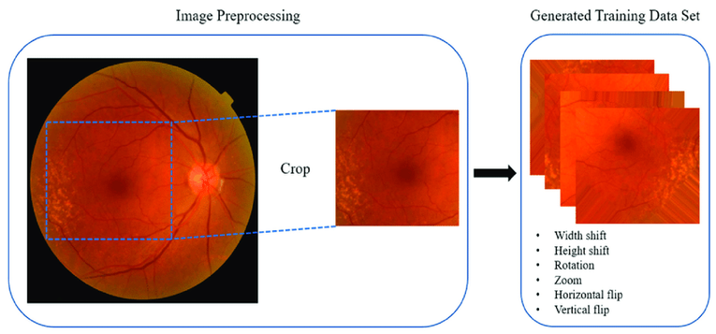
PROPOSED METHODOLOGY
2). Data Preprocessing:
It involves intricacies of the preprocessing steps, which encompass a spectrum of operations geared toward data refinement with the exigencies of our research. It involves
a). Image Preprocessing: It involves resizing images to a standardized dimension. For VQA models like Vilt-B32-MLM, square images are a common choice. Image pixel values are then normalized to a predefined range. The standard normalization techniques involve scaling pixel values to fall within the [0, 1] or [-1, 1] range.

Slide 15
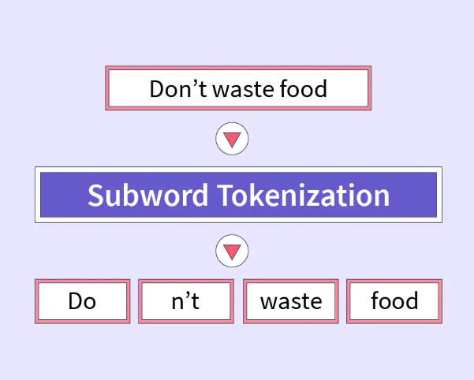
PROPOSED METHODOLOGY
2). Data Preprocessing:
b). Text Tokenization: It dissects text into smaller subword units. Tokens generated through subword tokenization are then mapped to their respective positions in the model’s vocabulary. Finally, tokens are encoded as numerical IDs. These numerical IDs represent the token’s position in the model’s vocabulary.

Slide 16
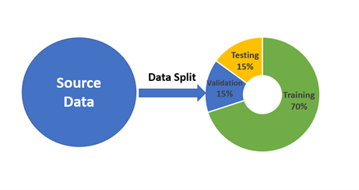
PROPOSED METHODOLOGY
2). Data Preprocessing:
c). Data Splitting: Data preparation also encompasses the division of the dataset into appropriate subsets. This involves the creation of training, val?idation, and test sets. Each subset serves a distinct purpose in the VQA pipeline.

Slide 17
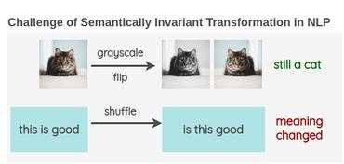
PROPOSED METHODOLOGY
2). Data Preprocessing:
d). Augmentation: Data augmentation involves performing operations on both images and text to generate additional training data. Image Augmentation involve operations such as image rotation, flipping, brightness adjustment, or cropping.Text augmentation involve textual paraphrasing or generating synonyms for words in questions.

Slide 18
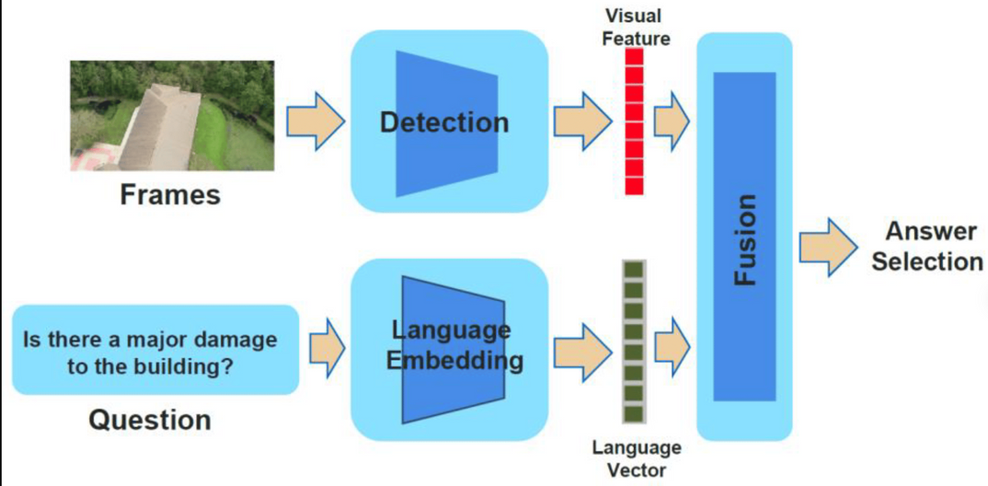
PROPOSED METHODOLOGY
2). Data Preprocessing:
e). Labeling and Answer Frequency Analysis: Labels are extracted from the predefined label set of the Vilt-B32-MLM model. Scores are calculated based on the frequency of answers in the dataset. Answers that occur more frequently are assigned higher scores, signifying their importance in the dataset

Slide 19
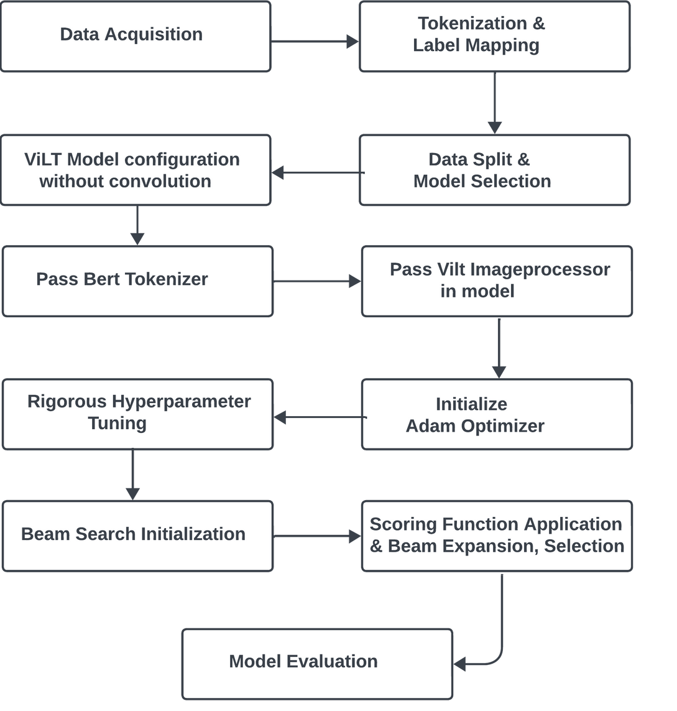
PIPELINE

Slide 20
PROPOSED METHODOLOGY
3). Model Selection and Configuration:
In the realm of Visual Question Answering, the selection of an appropriate model and its fine-tuned configuration significantly impact the overall performance and accuracy of the system.
a).Vilt: A State-of-the-Art Model: The Vilt-B32- MLM model is distinguished by its ability to seamlessly handle both visual and textual data. It brings together the power of the Vision and Language Transformer (VilT) and the Multimodal Transformer (MLM) to create a model that excels at understanding the intricate interplay between images and language. The Vilt-B32-MLM model is pretrained on a vast corpus of text and image data. The training process equips Vilt with a deep understanding of language and the capacity to extract meaningful features from images. The model’s pretrained weights are updated based on the specifics of the VQA task.
3

Slide 21
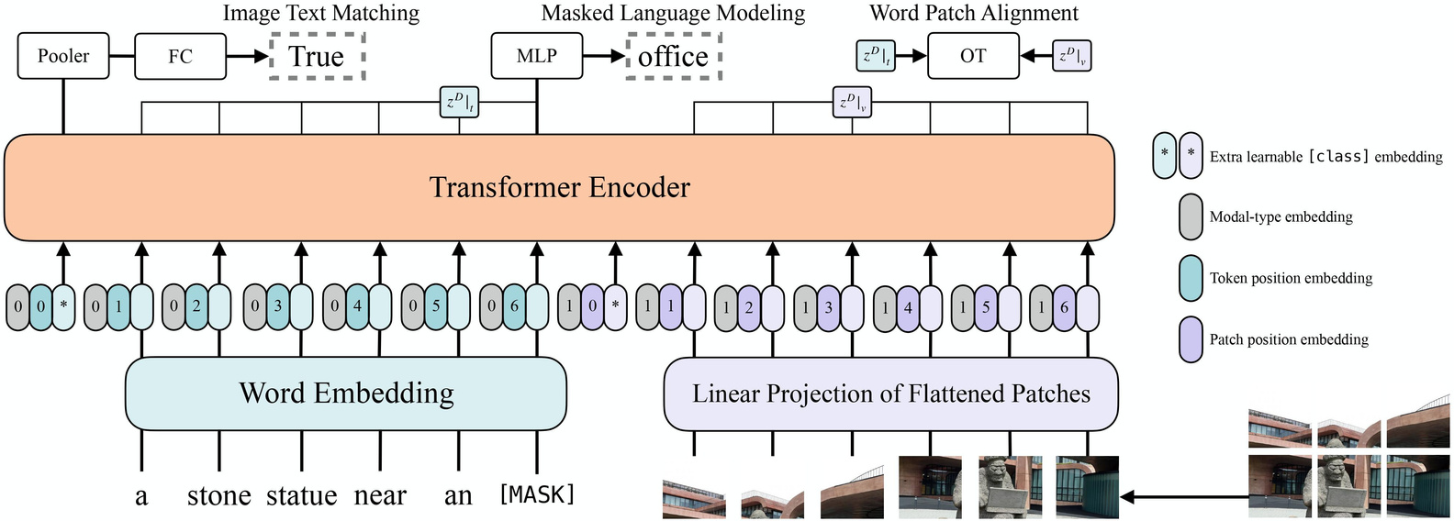
PROPOSED METHODOLOGY
3). Model Selection and Configuration:
a).Vilt: A State-of-the-Art Model:
The fine-tuning process involves modifying the model’s parameters to minimize the discrepancy between predicted answers and ground truth answers. The self-attention mechanism of transformers allows Vilt to model long-range dependencies in both the textual and visual domains. Fine-tuning tailors the model’s weights and biases to excel in this specific application, ensuring effective question answering.

Slide 22
PROPOSED METHODOLOGY
3). Model Selection and Configuration:
b).BeamSearch: Enhancing Text Generation:
BeamSearch is a strategy for generating coherent and contextually relevant text sequences. It maintains a set of multiple word sequences, known as ”beams,” at each decoding step. These beams represent different possible word sequences and allow for the simultaneous consideration of multiple answers.
At the start of decoding, a set of beams is initialized, each consisting of a single token ”start of sequence” token. At each decoding step, the model generates multiple candidate words for each active beam. The top-k candidates with the highest scores are retained for further decoding. The retained candidates are used to extend the beams, forming new sequences.

Slide 23
PROPOSED METHODOLOGY
3). Model Selection and Configuration:
b).BeamSearch: Enhancing Text Generation:
This process continues, with beams being further extended and evaluated at each step .It continues until a predefined maximum sequence length is reached or until specific termination conditions are met. Once the decoding process is complete, the beam with the highest overall score is selected as the final output.
One of the key components of Beam Search integration is the scoring function. This function is designed to guide the Beam Search process and assess the quality of candidate sequences. It plays a vital role in determining which sequences are retained for further exploration and which are discarded.

Slide 24
PROPOSED METHODOLOGY
4). Model Training and Evaluation:
. Each iteration through the training data guides the model toward the optimization of its predictive capabilities. The guidance provided to our model during training is encapsulated within a Loss Function.
The Optimization process is enacted through an optimizer, such as the AdamW optimizer, and centers on iteratively refining the model’s parameters. The efficacy of model training hinges on Hyperparameter Tuning. Parameters related to learning rates, batch sizes, and optimizer configurations are scrutinized and adjusted to strike a balance between swift convergence and the avoidance of overfitting.

Slide 25
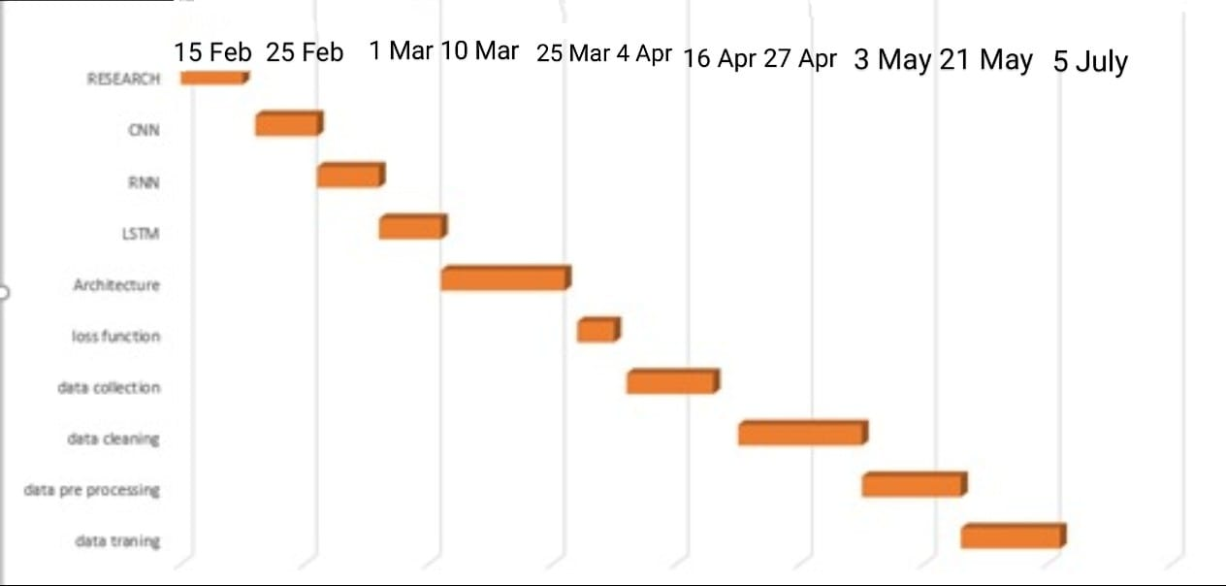
Timeline

Slide 26
Coverage of Questions
Question types answered: What,When
(descriptive, factual, and interpretive questions)
Logical reasoning capabilties:Satisfactory
Classification capabilities:Excellent
Object detection capabilities:Excellent

Slide 27
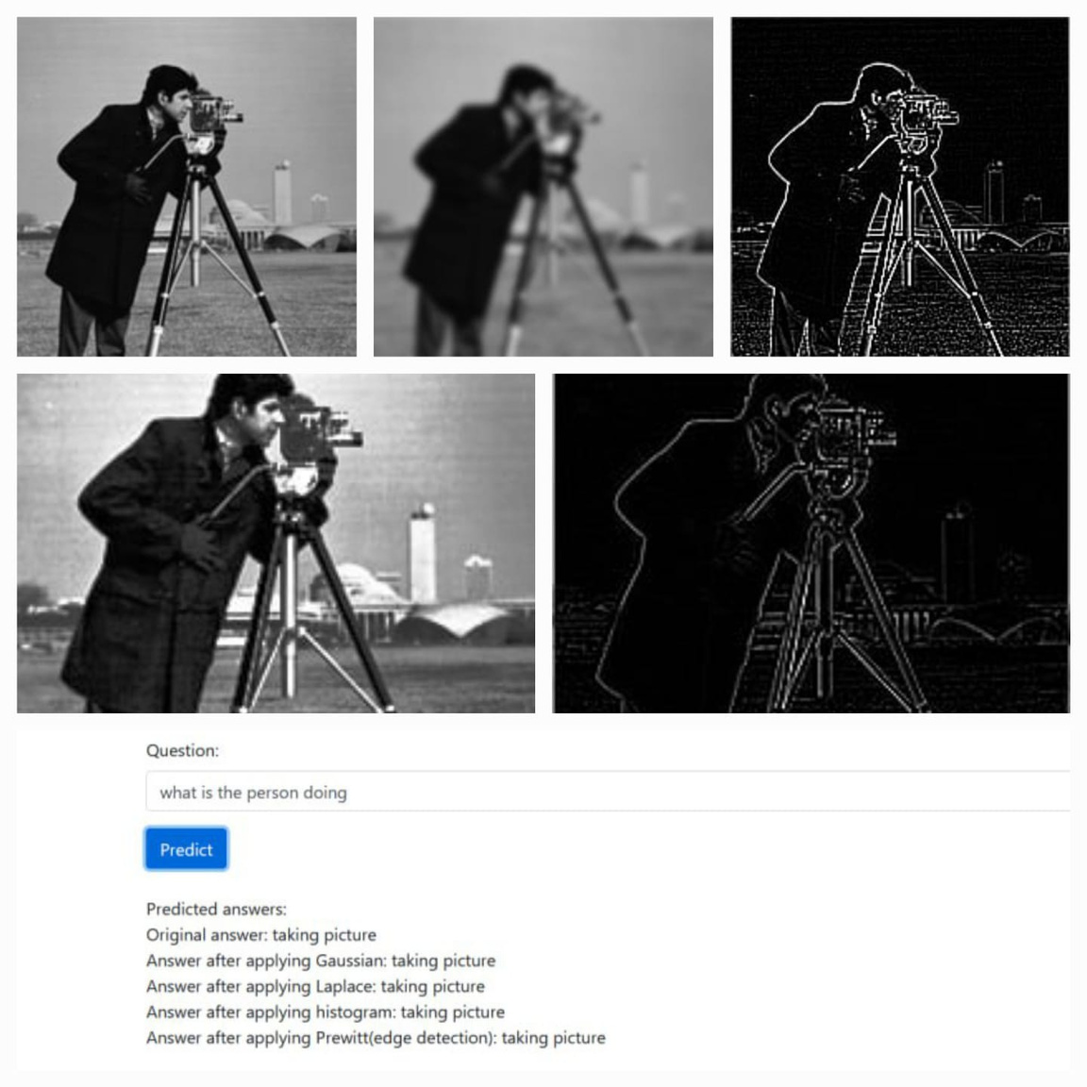
OUTPUT RESULT

Slide 28
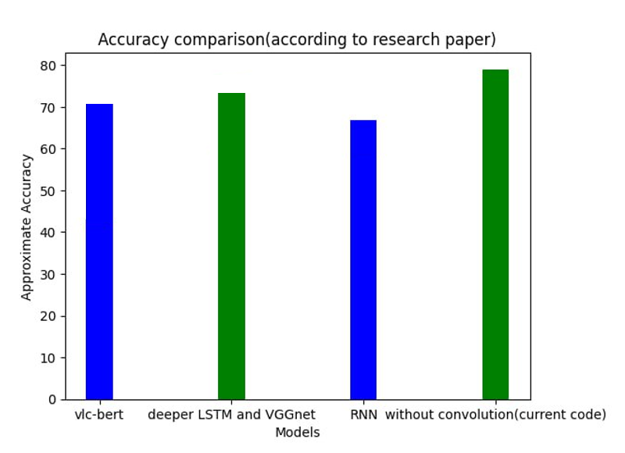
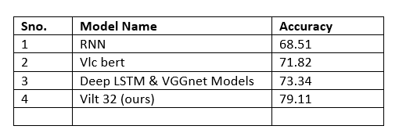
COMPARSION WITH OTHER MODELS

Slide 29
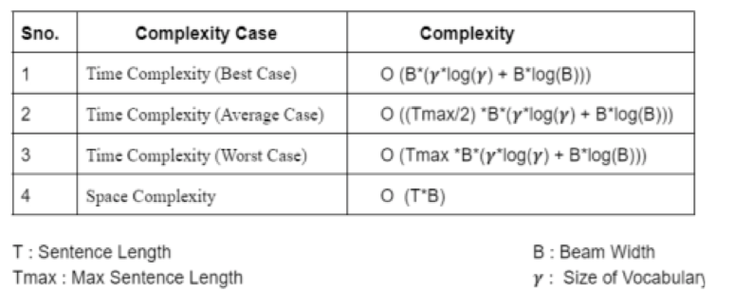
TIME COMPLEXITY

Slide 30
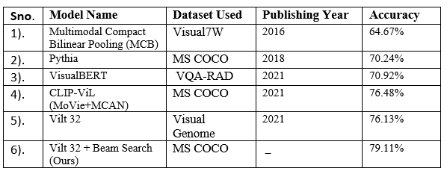
COMPARSION WITH OTHER MODELS

Slide 31
CONCLUSION
Visual Question Answering merges computer vision and natural language processing to enable machines to comprehend images and respond to questions about them. This intricate task involves extracting visual features, analyzing questions, fusing visual and textual information, reasoning, and generating accurate answers, holding great potential for applications that demand human-like interaction with visual content.

Slide 32
Future Scope
As our research journey in Visual Question Answering (VQA) progresses, we recognize several avenues for future work that can enhance and expand the hori zons of VQA systems. These potential directions pave the way for continued innovation and evolution in the field. The integration of multimodal transform ers, as seen in models like Vilt-B32-MLM, provides a solid foundation for VQA systems. Future work can explore more advanced multimodal architectures and transformer variations to further improve the understanding of the complex in terplay between visual and textual information. The application of VQA in real-time scenarios, such as virtual assistants or autonomous vehicles, presents an exciting challenge. Future work can explore techniques to make VQA systems more efficient and responsive in real-time en vironments. Advancements in computer vision can empower VQA systems to provide more detailed and fine-grained answers. Future work can explore tech niques to enhance the model’s ability to comprehend intricate details in images.

